Slide 1
motion-monitoring system
remotely over WebSocket
Sohani Rao, Francine Craven

Slide 2
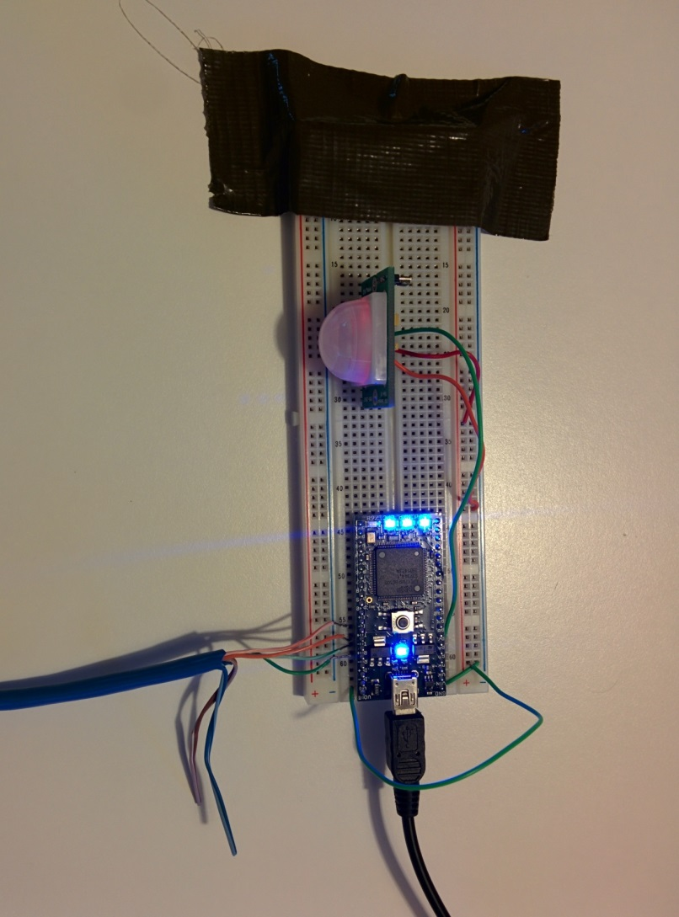
Set-up
Breadboard with MBED microcontroller, powered by laptop
Parallax PIR motion sensor connected to MBED GND, VOUT, and DigitalIn P6
Router connected to Internet
Ethernet cable connected to router and to MBED TD and RD pins

Slide 3
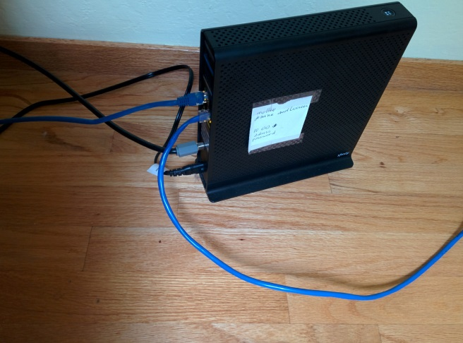
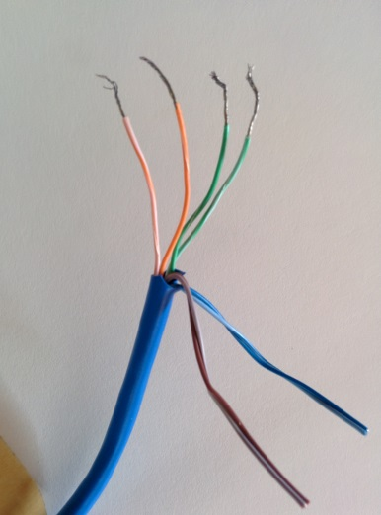

Set-up with router
Router and cable
DHCP-assigned IP address
IP address is 10.0.0.7
[WebSocket : INFO]
host: sockets.mbed.org
path: /ws/sensor/rw
port: 443
Ethernet connection to MBED:
RD+ (35) Green
RD-(36) Green/White
TD+ (33) Orange
TD- (34) Orange/White
Sensor connection to MBED: OUT connected to pin6

Slide 4
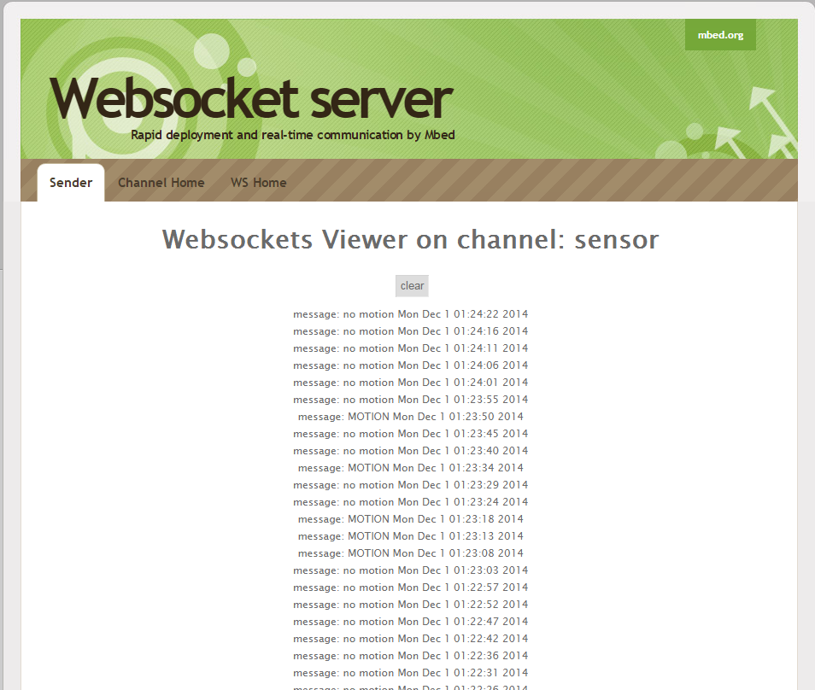
Visual outputs
Tera Term console
Web browser
http://sockets.mbed.org/sensor/viewer

Slide 5
Sensor specifics
Parallax Passive Infra-Red motion sensor has 3 pins: GND, Vcc, OUT
Data out is 1 if movement detected, 0 if not.
Sensor stays lit for 5 seconds after trigger.
Jumper setting: 30ft or 15ft max detection radius
~180-degree sweep

Slide 6
Milestones
Acquire components
Integrate sensor input, inspired by FEESD program example 7.9, bidirectional data transfer between UARTs
Communicate over Ethernet: inspired by http://developer.mbed.org/handbook/Ethernet-Interface
Connect to Internet: inspired by http://developer.mbed.org/handbook/Ethernet-Interface, TCP HelloWorld example
Integrate WebSockets: inspired by http://developer.mbed.org/teams/mbed/code/Websocket_Ethernet_HelloWorld/
Display correct timestamp with sensor reading

Slide 7
Enhancements
Bidirectional operation, with Websocket server running on Mbed and send messages from websocket client (browser) to control the system
Interfacing with an RFID detector to turn off motion detection within 5-10 seconds of entering an apartment, for example. Additionally, interfacing with an alarm to indicate intruder.
Liquid-crystal display on the breadboard for reflecting motion detection and local time.
Interface with Rest APIs to control the system from twitter and to send motion monitor reports

Slide 8
References and acknowledgements
Fast and Effective Embedded Systems Design, 2012, Rob Toulson and Tim Wilmshurst, Elsevier Ltd.
https://developer.mbed.org/cookbook/Homepage, and mbed developer community
http://www.parallax.com/downloads/pir-sensor-rev-b-product-guide
UCSC 4357 community
Wikipedia –
Getting started with Ethernet http://developer.mbed.org/forum/mbed/topic/423/
Ethernet wiring http://developer.mbed.org/forum/mbed/topic/1239/

